Slide 1
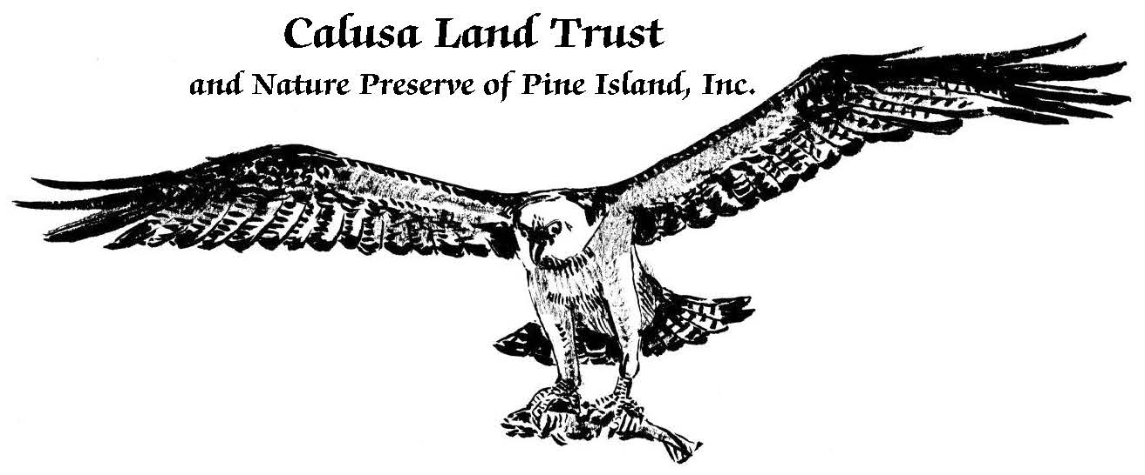
bbb
Pine Island’s all-volunteer Land Trust

Slide 2
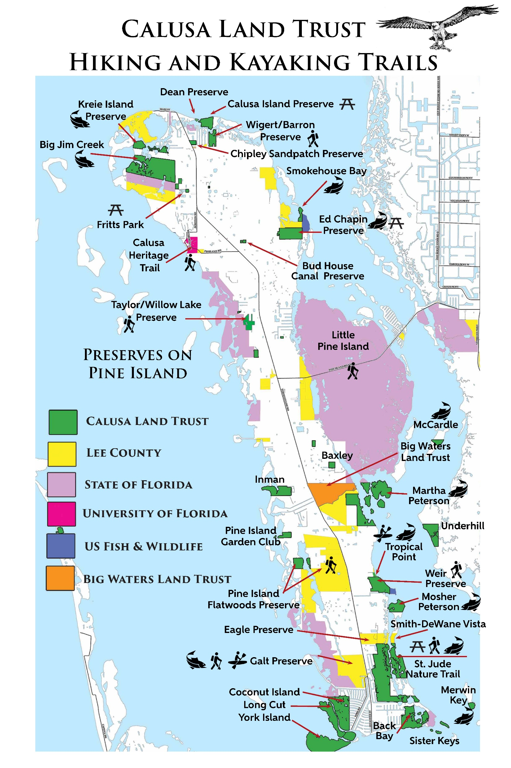

Slide 3

Founded in 1976 as Calusa Land Trust and Nature Preserve Association with 4 original members
Main focus was to protect Calusa Island on northeast end of Bokeelia
In 1989 it incorporated into the Calusa Land Trust and Nature Preserve if Pine Island Inc. and expanded its reach
Today we own and steward just over 2,400 acres on or adjacent to Pine Island.

Slide 4
Mission Statement
To protect the natural diversity and beauty of Pine Island. We acquire, preserve and manage environmentally sensitive, historical and archaeologically important sites. We foster appreciation for and understanding of the environment and our past.

Slide 5


Slide 6
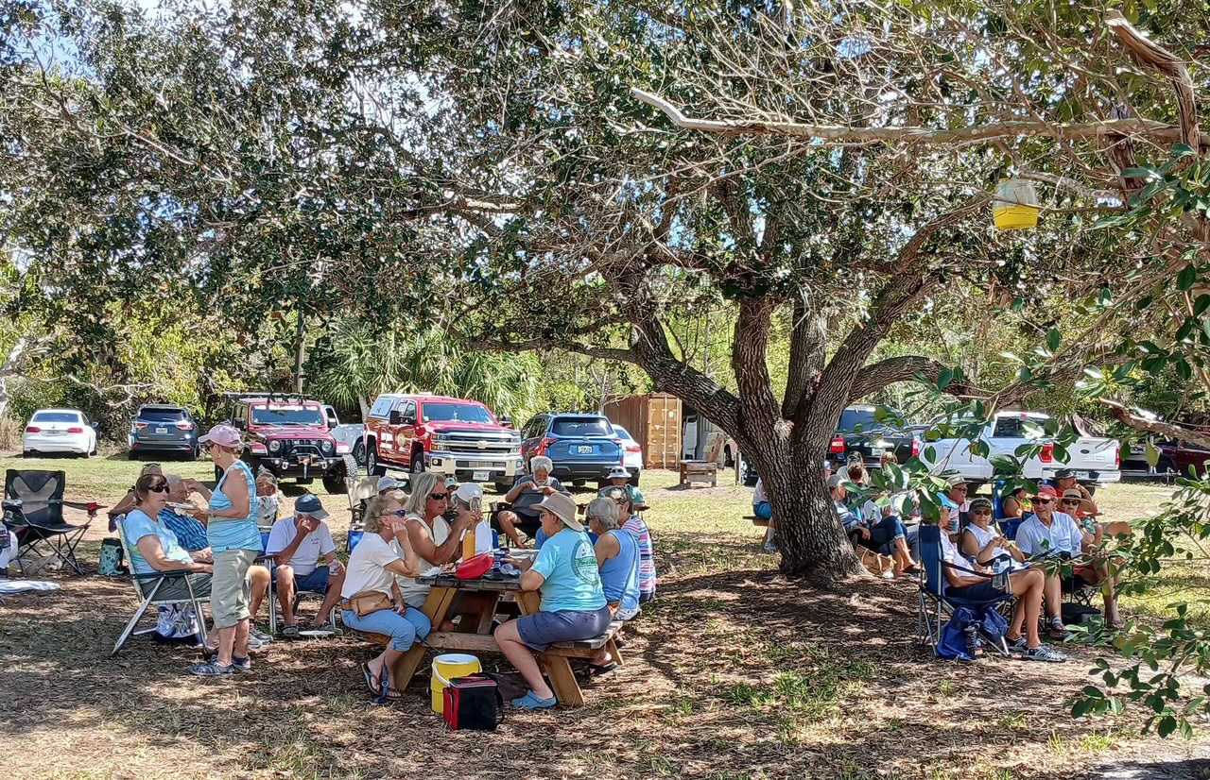
50th Anniversary Picnic

Slide 7
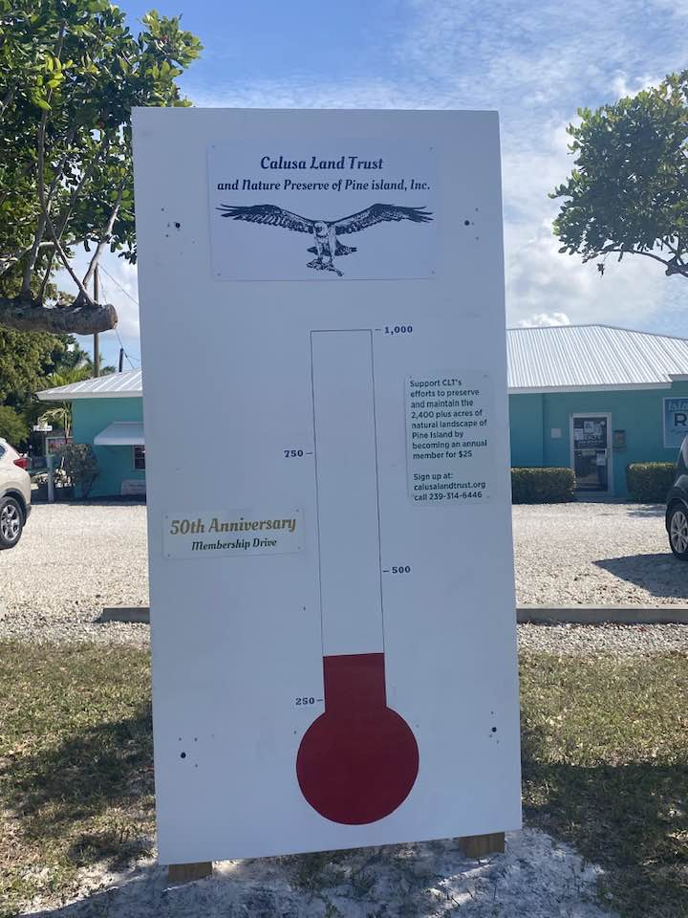
Membership Drive

Slide 8
What can you do to help?
Become a member!
8,566 Pine Island Residents
(2022 data census.gov)
Aiming to boost membership to 1,000

Slide 9
Why is Membership Important?
The $25 annual membership fee helps support the cost of maintaining the 8 publicly assessable preserves
The number of members shows community support when CLT applies for grant monies

Slide 10
Why is Membership Important?
The $25 annual membership fee helps support the cost of maintaining the 8 publicly assessable preserves
The number of members shows community support when CLT applies for grant monies

Slide 11
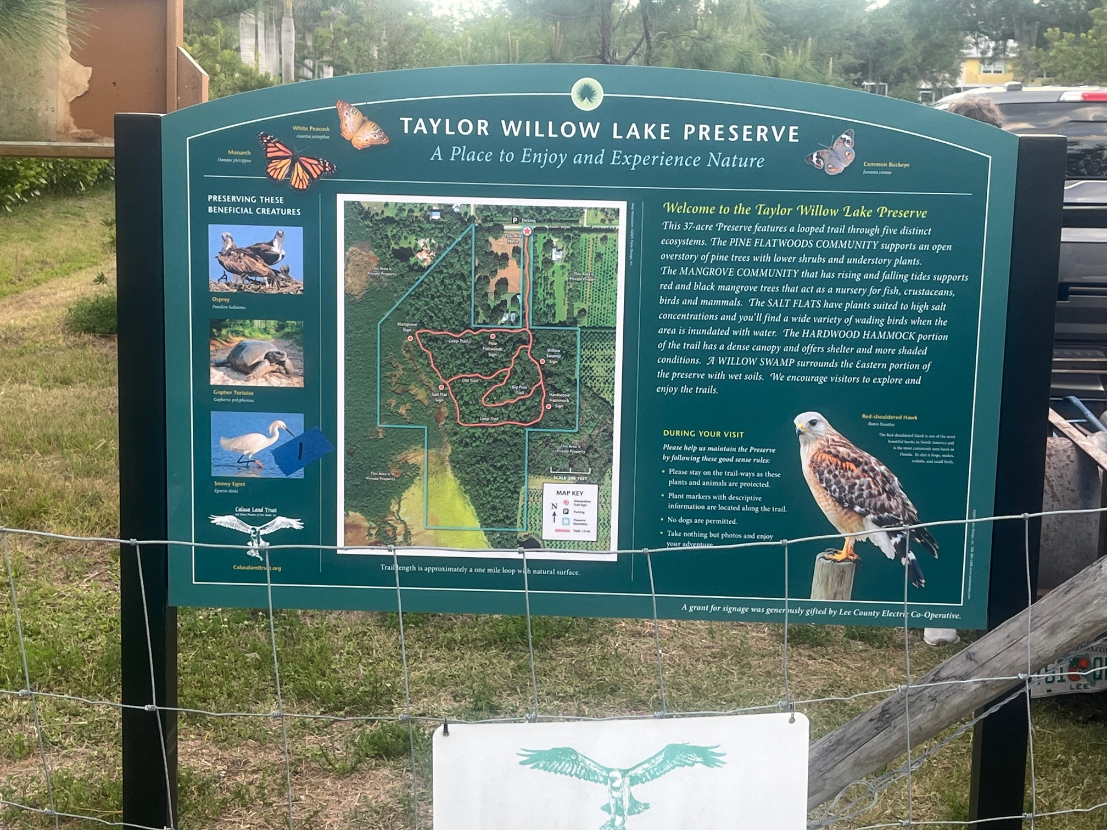
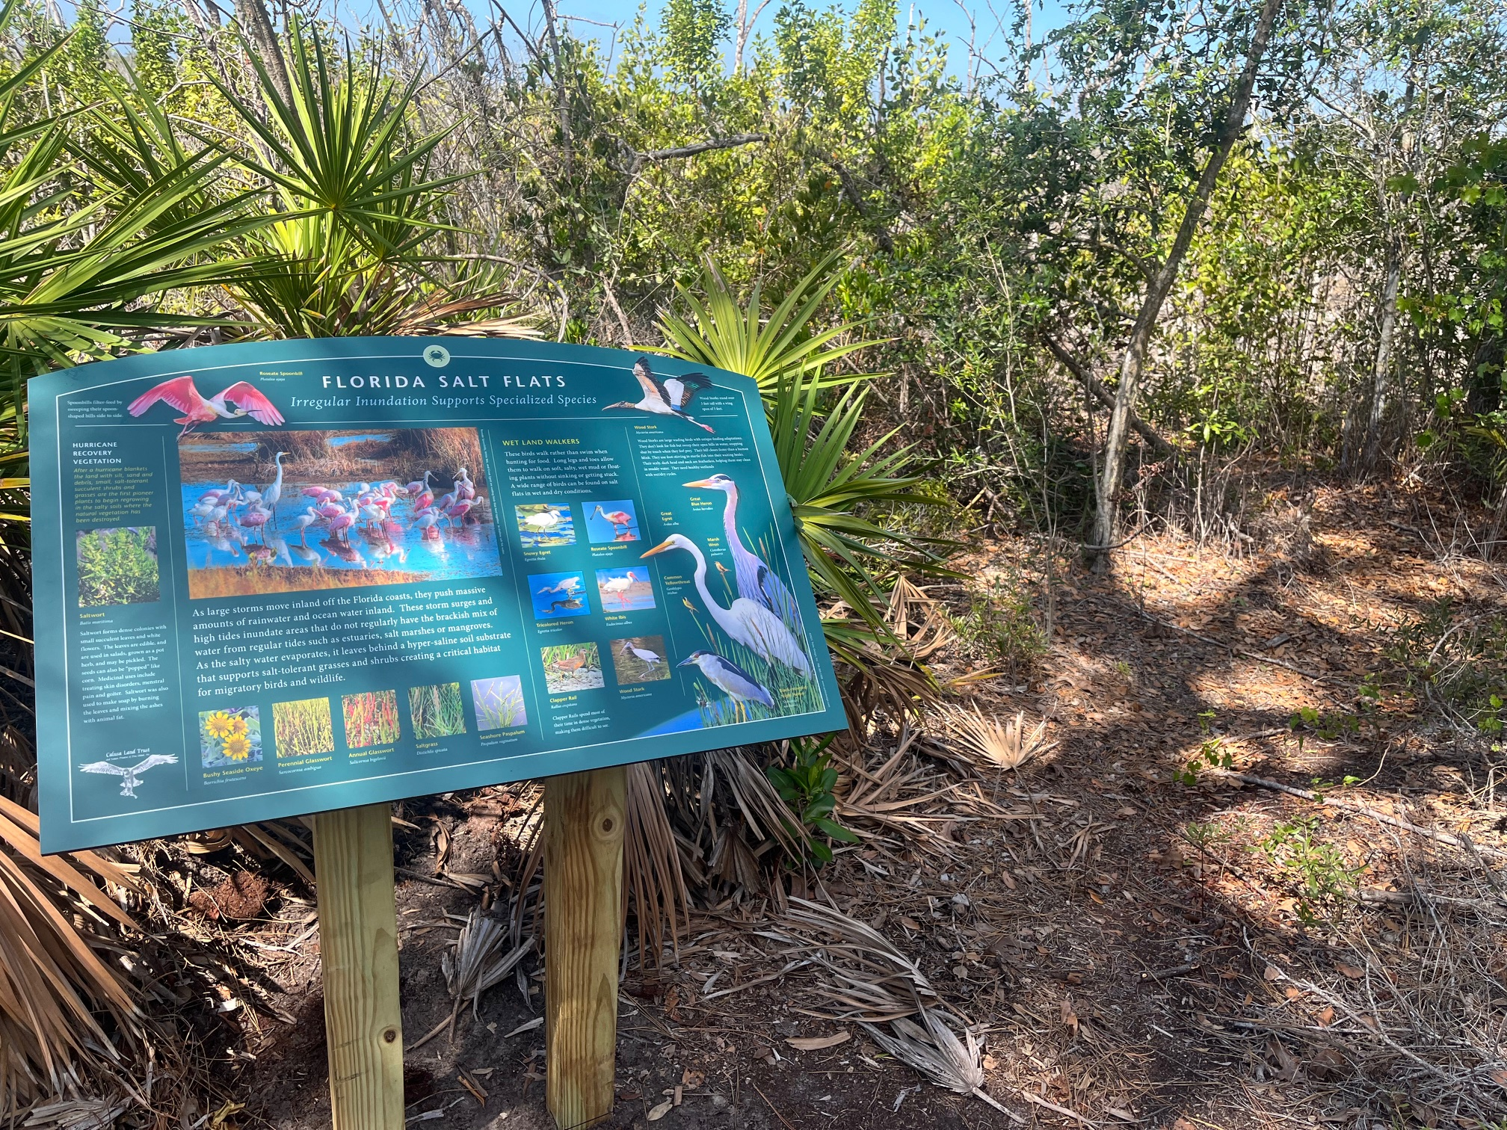
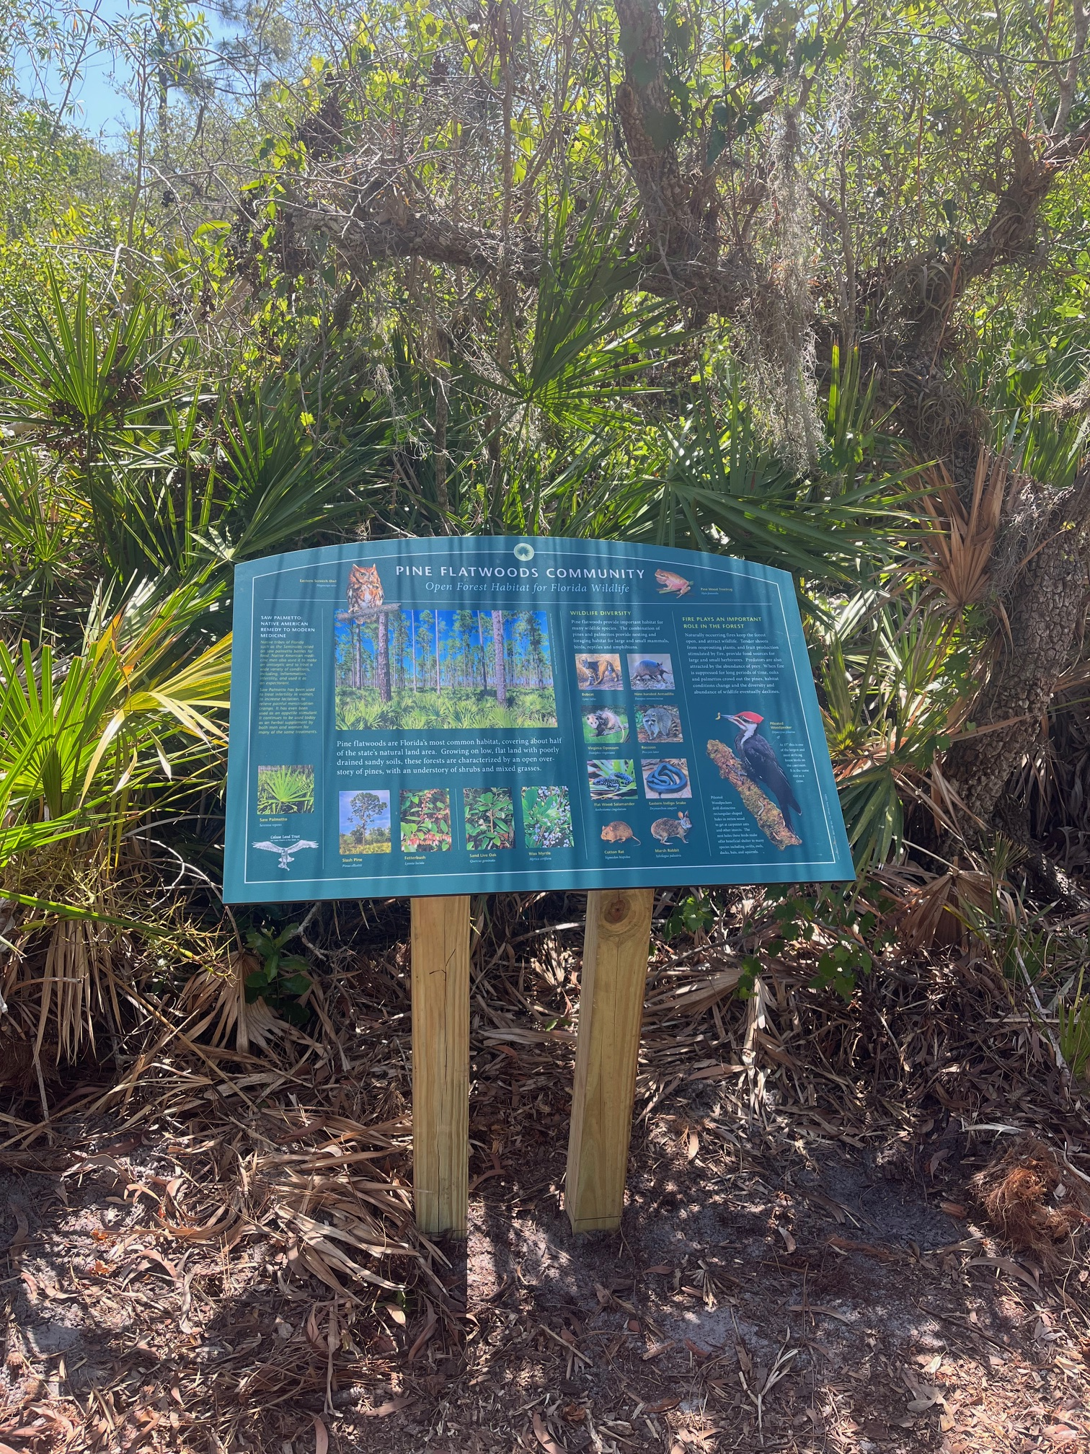
Recent Grants
Lee County Electric Coop
Preserve and interpretive signs for Taylor-Willow Lake Preserve

Slide 12
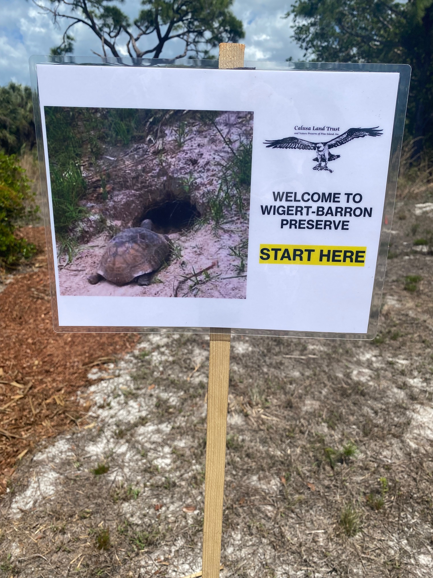
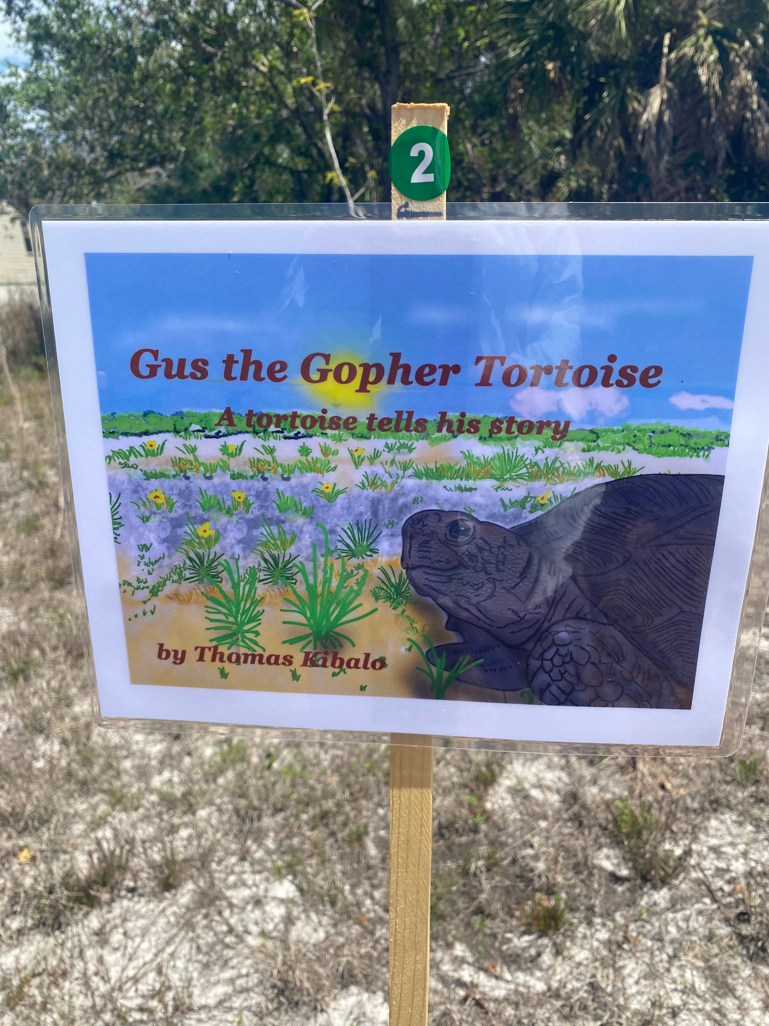
Recent Grants
Lee County Electric Coop
Children’s Story Walk at Wigert-Barron Preserve to commemorate Gopher Tortoise Day

Slide 13
Recent Land Purchase

Slide 14
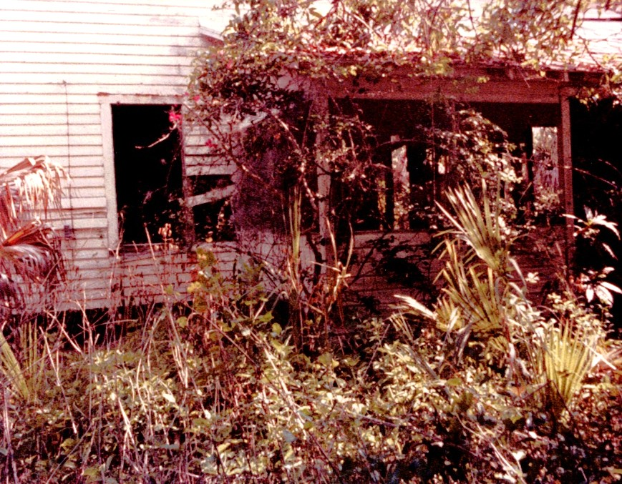
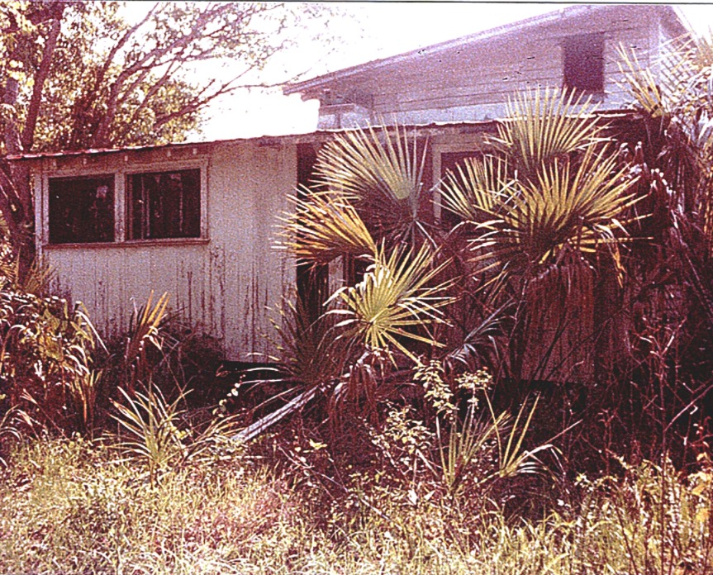
Recent Grants
Coastal and Heartland National Estuary Partnership (CHNEP)
Restoration and Cleanup of new Chipley Sandpatch Preserve (Phase 1)
Chipley Homestead 1984

Slide 15
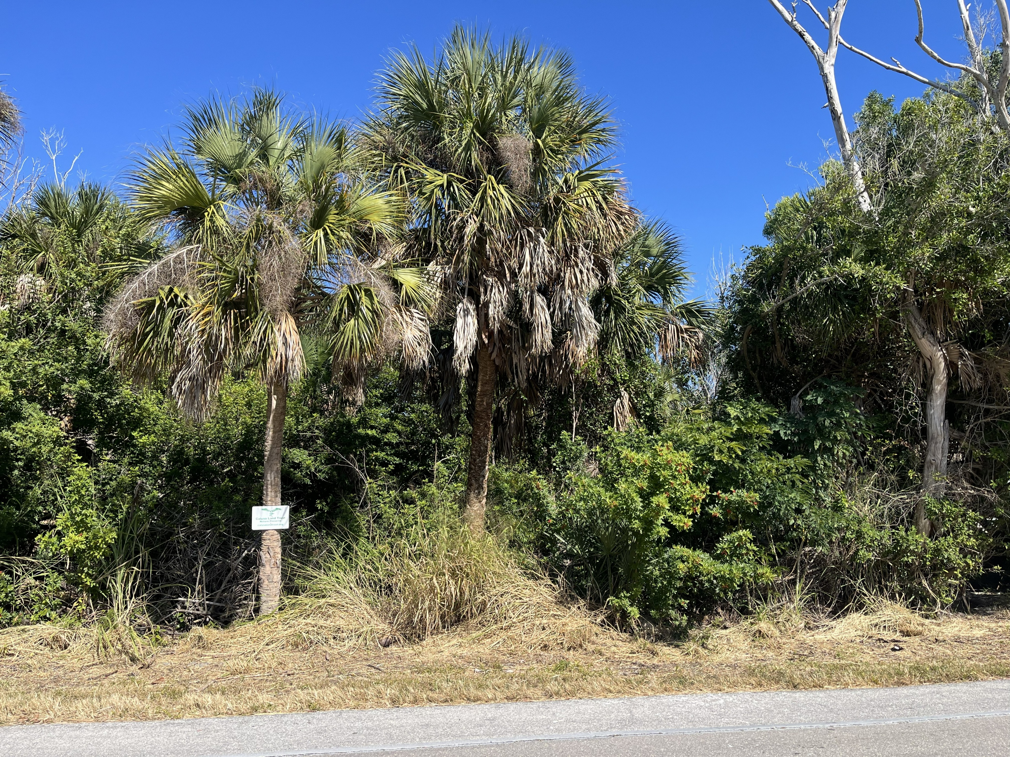
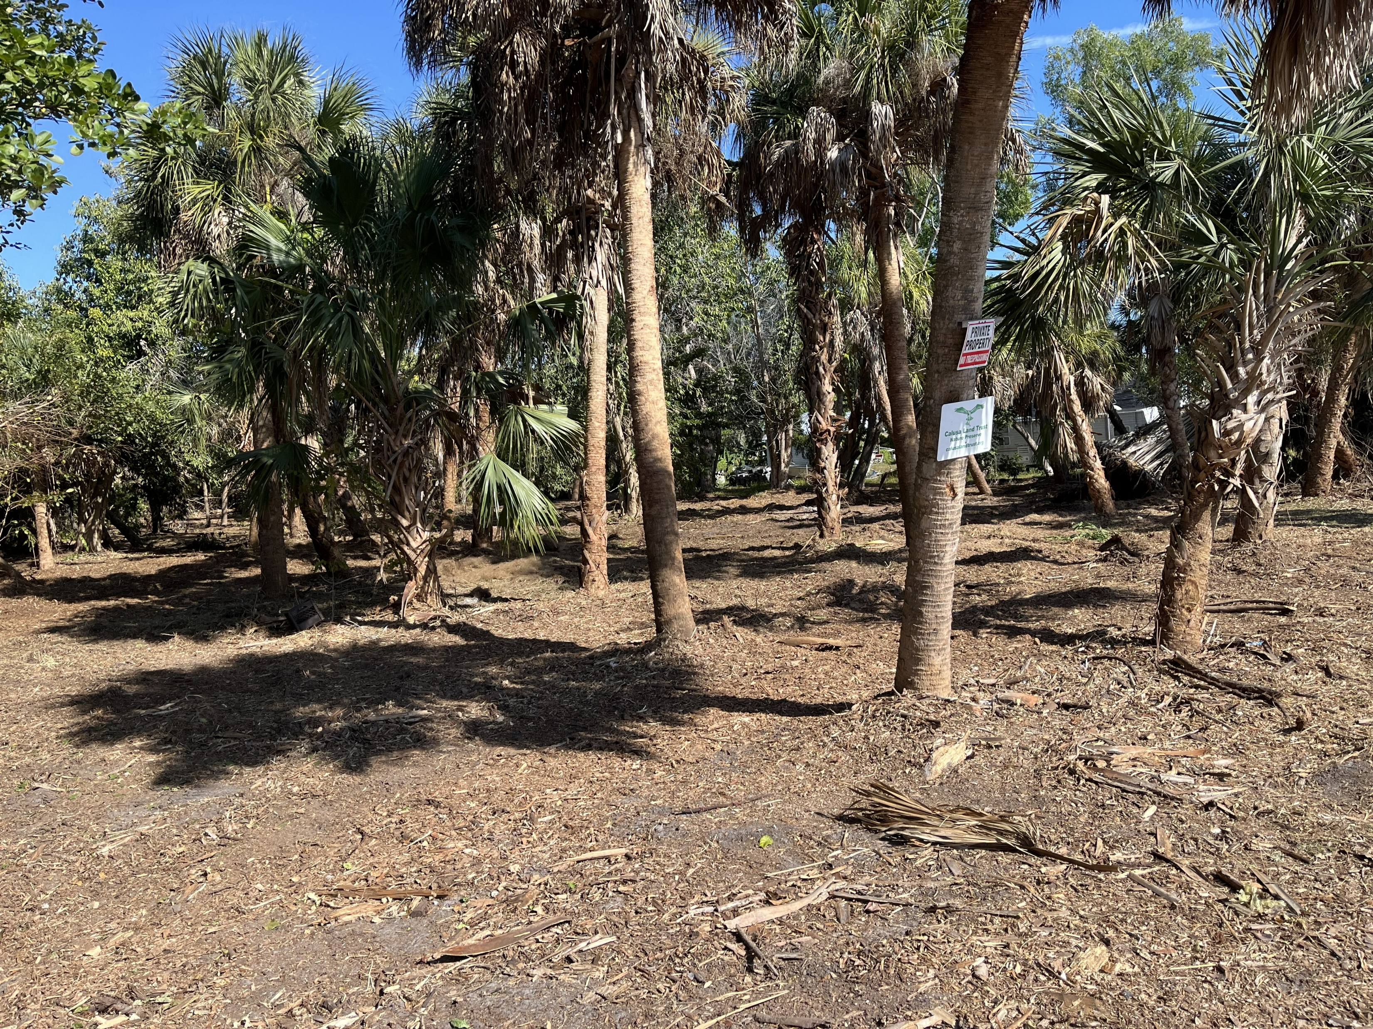
Recent Grants
Coastal and Heartland National Estuary Partnership (CHNEP)
Restoration and Cleanup of new Chipley Sandpatch Preserve (Phase 1)
Before
After

Slide 16
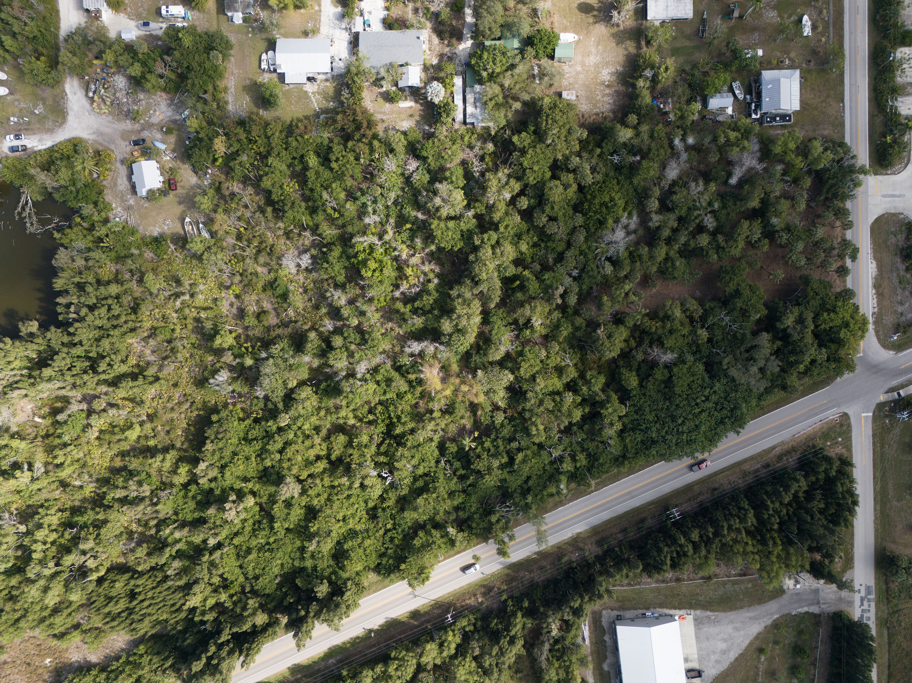
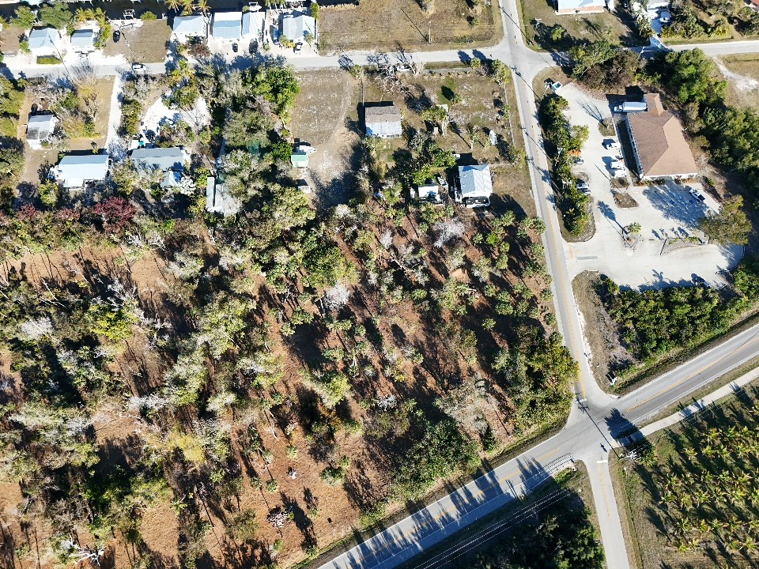
Recent Grants
Coastal and Heartland National Estuary Partnership (CHNEP)
Restoration and Cleanup of new Chipley Sandpatch Preserve (Phase 1)
Before
After

Slide 17
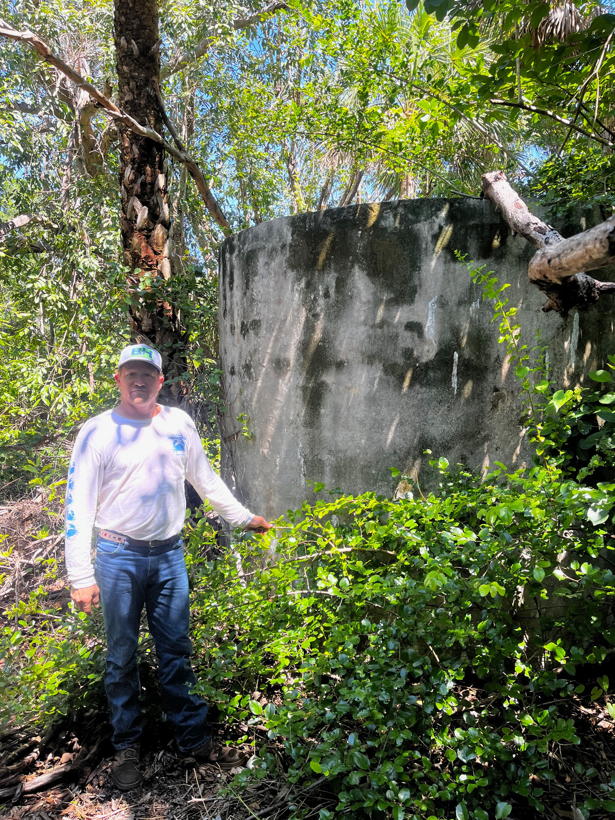
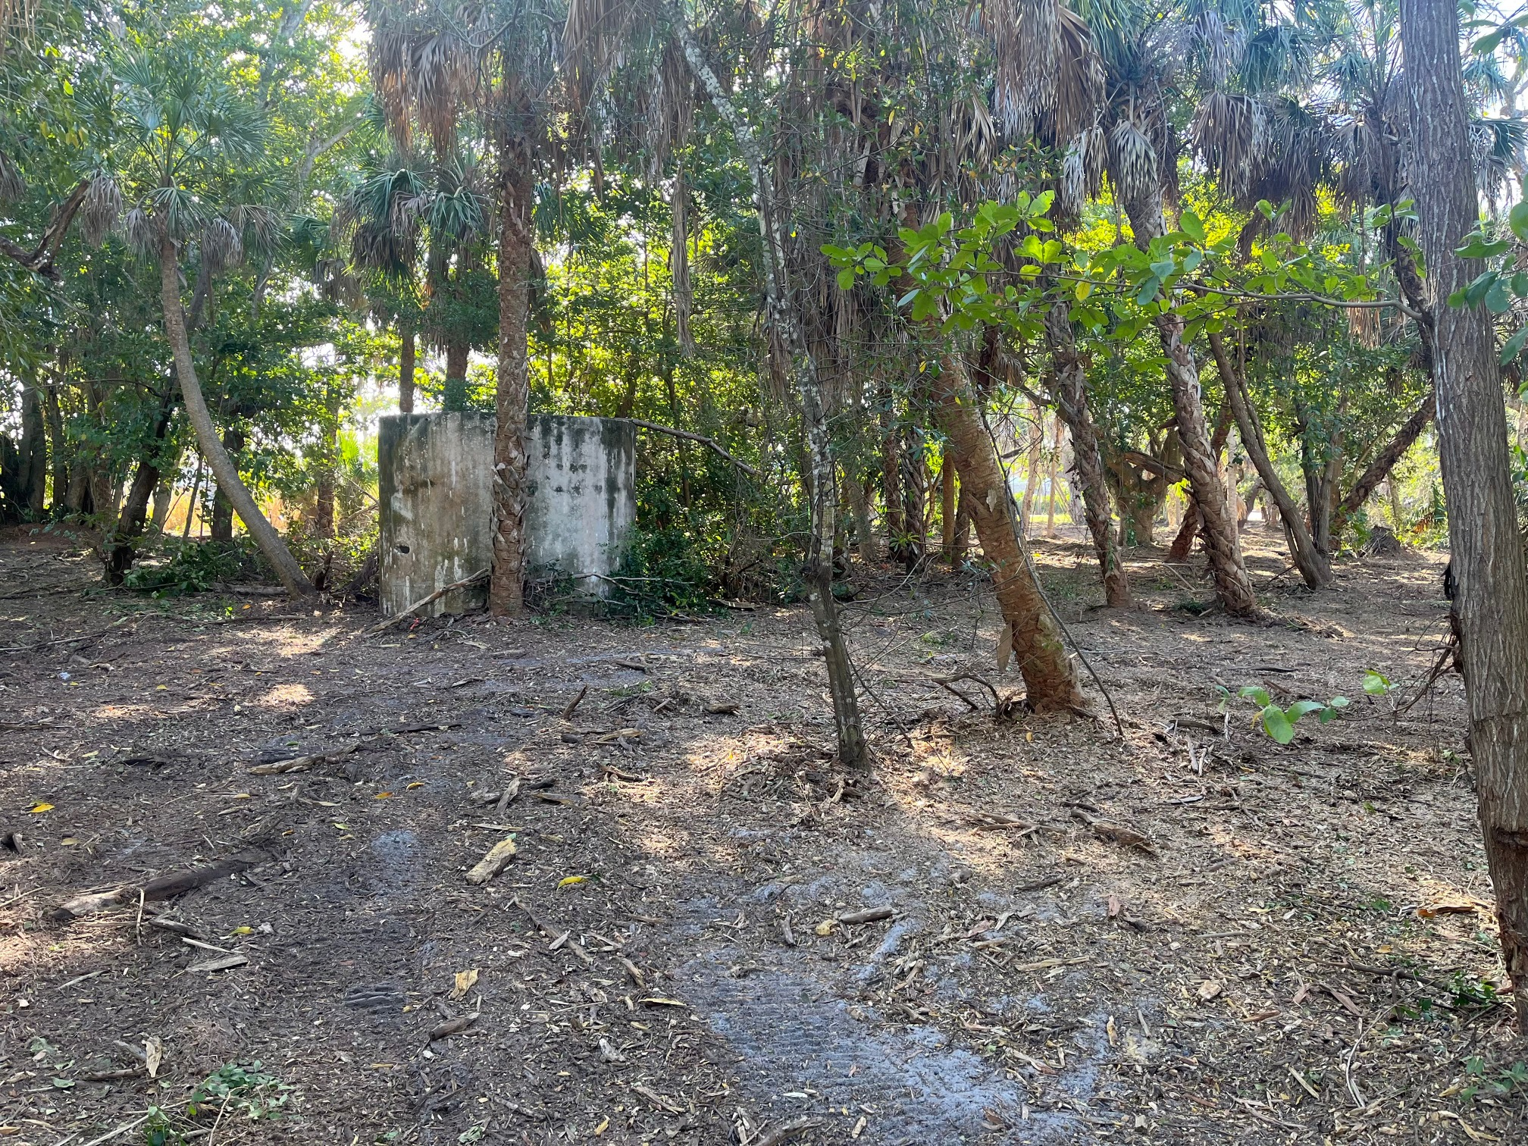
Recent Grants
Coastal and Heartland National Estuary Partnership (CHNEP)
Restoration and Cleanup of new Chipley Sandpatch Preserve (Phase 1)
Before
After

Slide 18
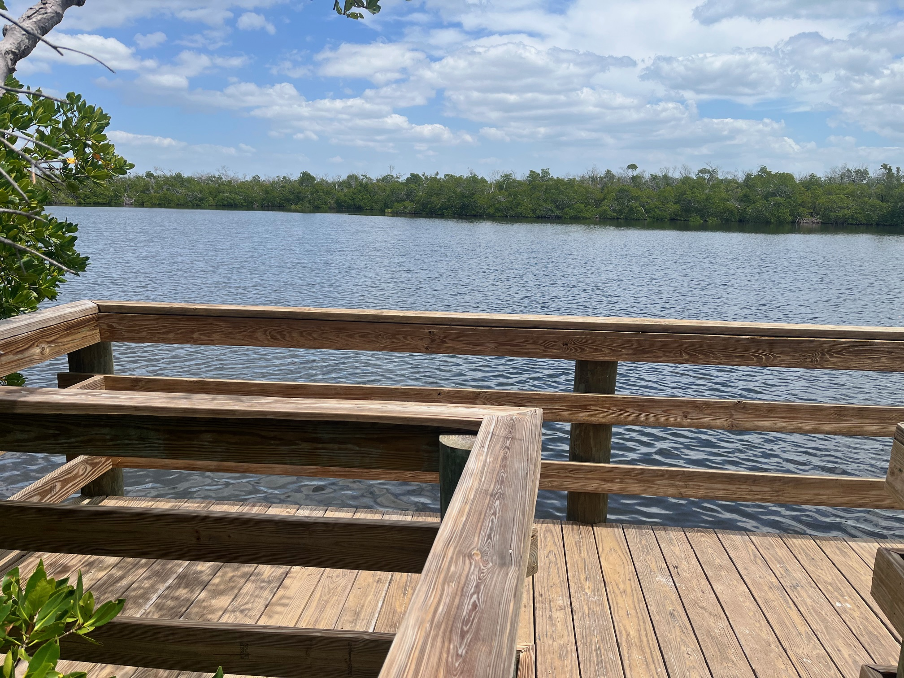
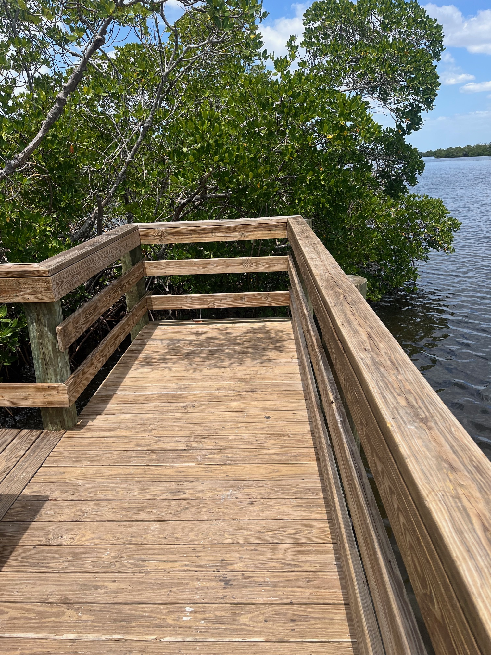
Upcoming Projects
St Jude Trail
Finish pattern for the Codty Pierce Memorial Bench on the St James Creek overlook platform (Calusa Waterkeepers request) and build

Slide 19
What can you do to help?
Become a member!
Donate to CLT (Land and/or Money)!
Volunteer at Monthly Work/Fun Parties!
Help with CLT Events!

Slide 20
How to Follow CLT
Web Page: www. calusalandtrust.org
Facebook: Calusa Land Trust
Calusa Land Trust Newsletter
Pine Island Eagle

Slide 21

Working to save some of “Pine” Island for tomorrow!

Slide 22
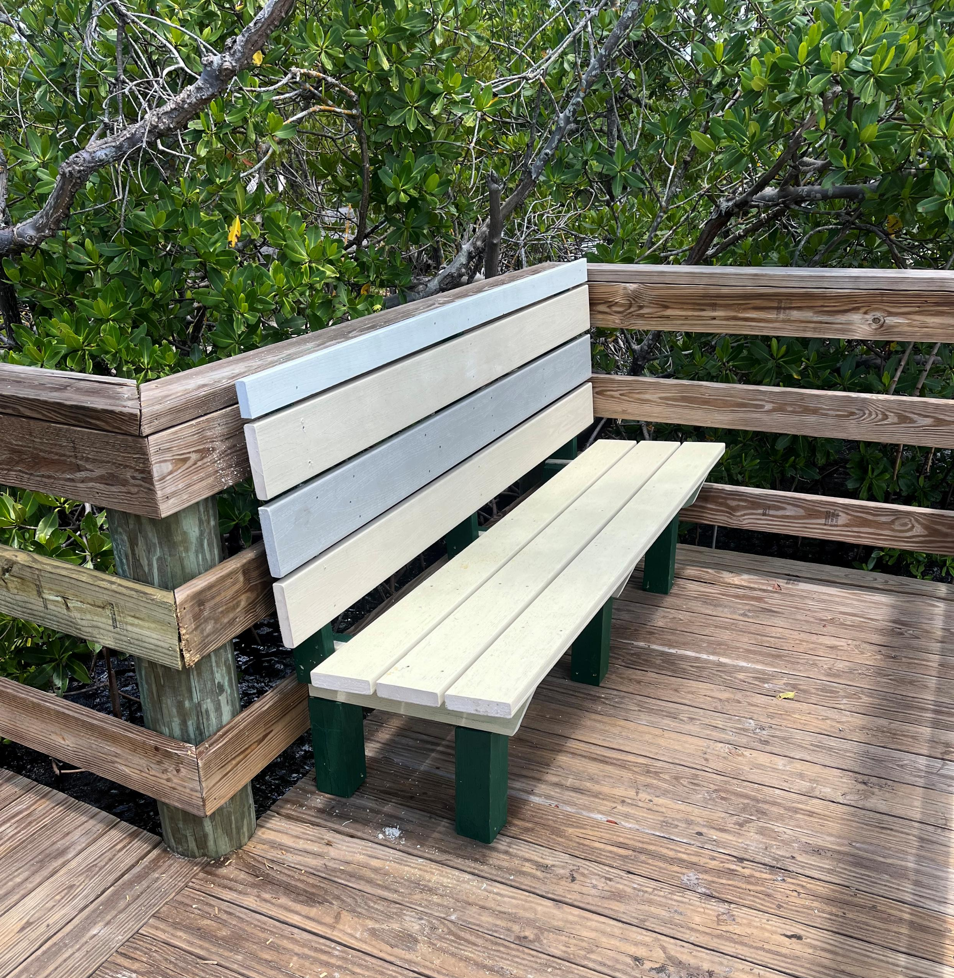
Codty Pierce
Memorial
St. Jude Trail

